Slide 1
What’s in a realist’s mind?
uncovering Aristotle and Locke’s way of thinking
Ferra Suryani | fks2114

Slide 2
Project Background and Description
Diving deeper into two key philosophers’ thoughts in the Realism school of philosophy - Aristotle and John Locke
Realism emphasizes on “reality, knowledge, and value exist in the human mind”
Objectives
Unveil Aristotle and Locke’s minds by analyzing the text contained in their works.

Slide 3
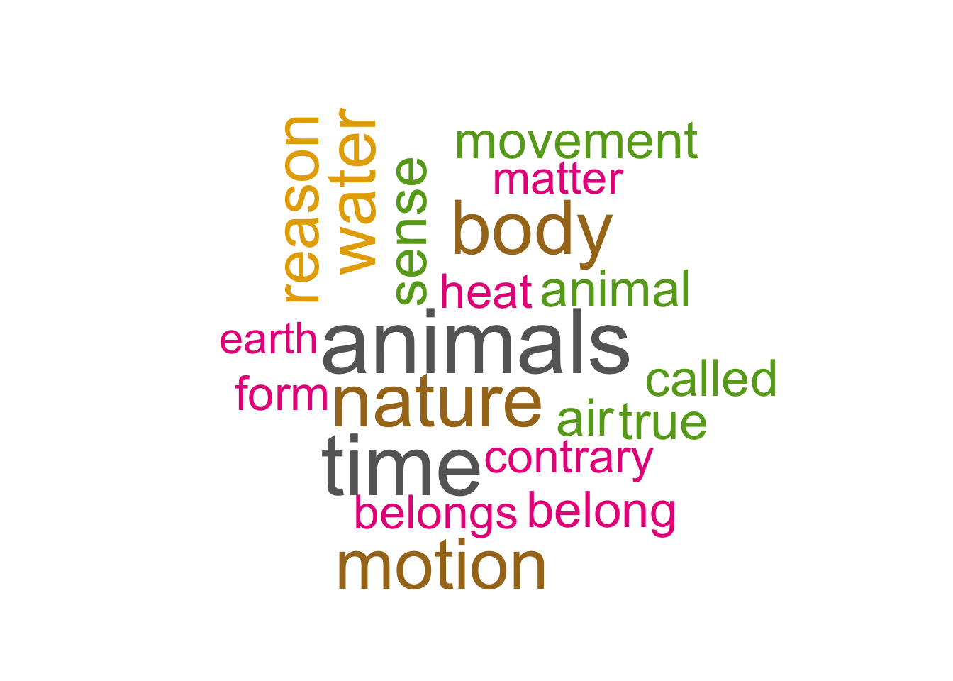
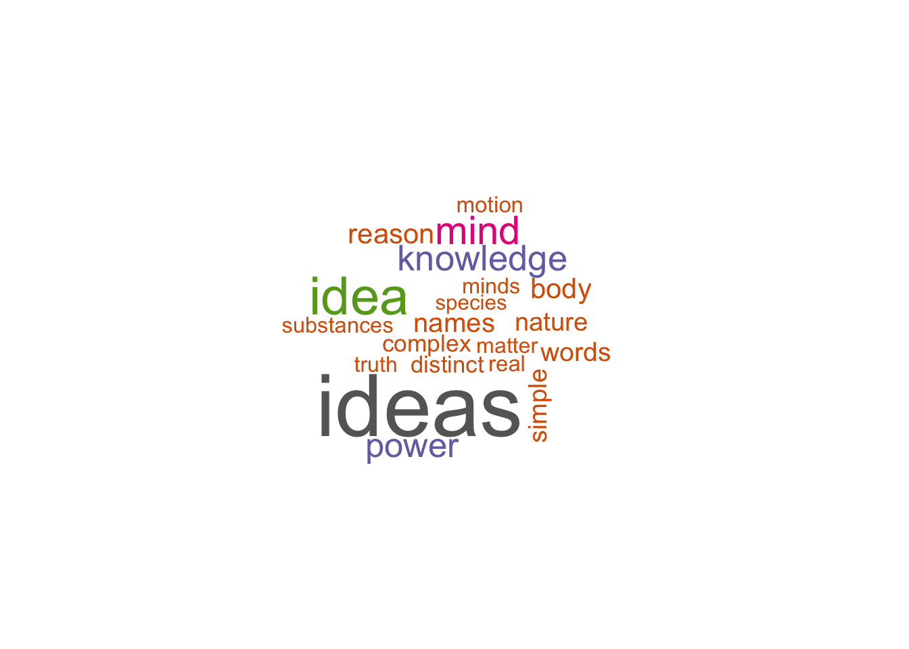
Q1 - what words did Aristotle and Locke use most often in their respective works?
Aristotle
nature or object focused words
Locke
specific to human’s logical mind

Slide 4
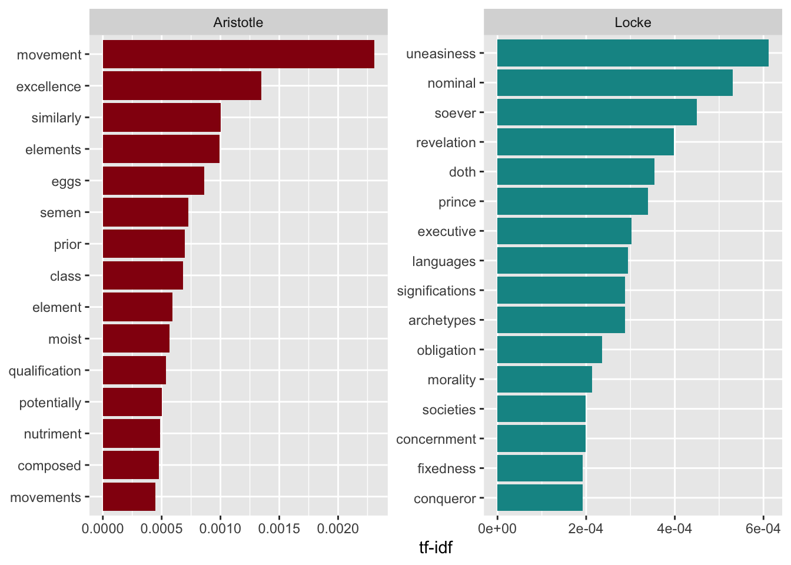
Q2 - what are the most meaningful words used in their works?
Aristotle
Achievements-related keywords: “excellence”, “qualification”, “nutriment”
Locke
ethics-related keywords:
“Morality”, “societies”, “concernment”, “archetypes”
Hierarchy-related keywords:
“Executive”, “prince”, “conqueror”

Slide 5
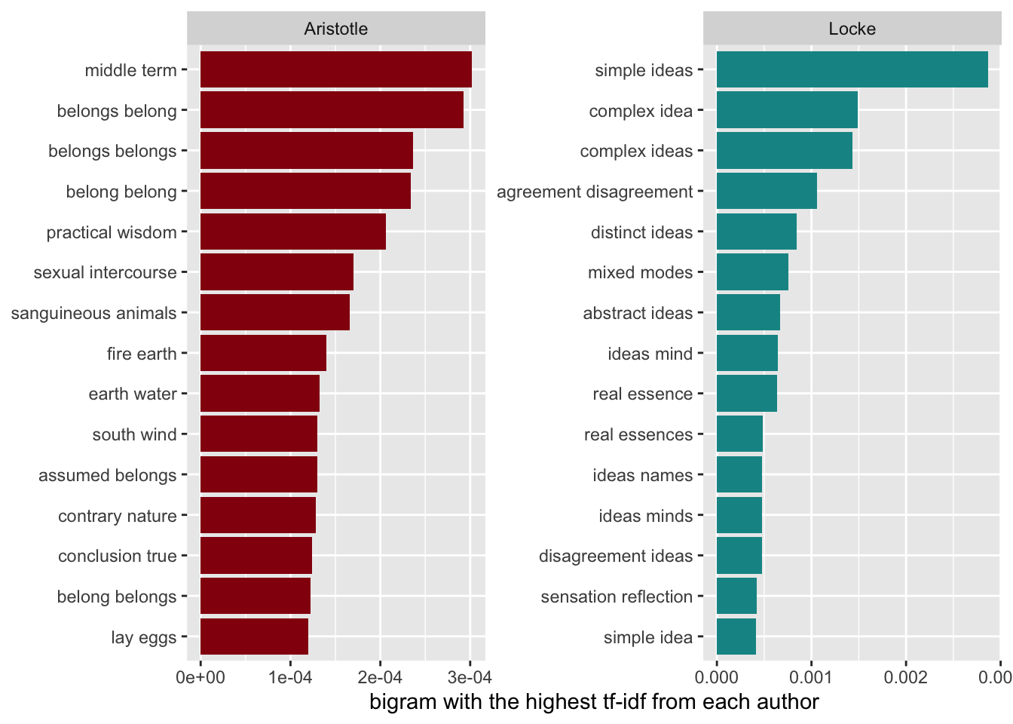
Q2 - what are the most meaningful words used in their works? (bigram)
Aristotle
Object-oriented word pairings
“Fire earth”, ‘earth water”, “south wind”
Locke
Concepts and logical word pairings
“Abstract ideas”, “distinct ideas”, “complex ideas”

Slide 6
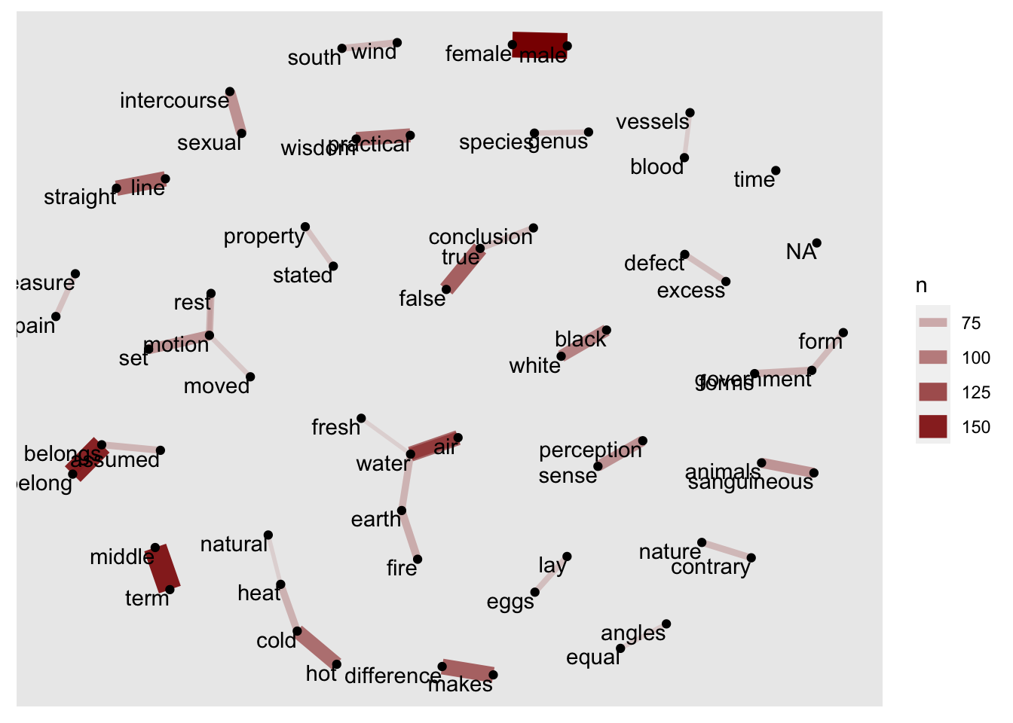
Q3 - is there a relationship among words that appeared more than 50 times?
Aristotle
nature-related words appeared most often: “fresh”, “air”, “water”, “earth”, “fire”
Object-oriented words: “blood”, “vessels”

Slide 7
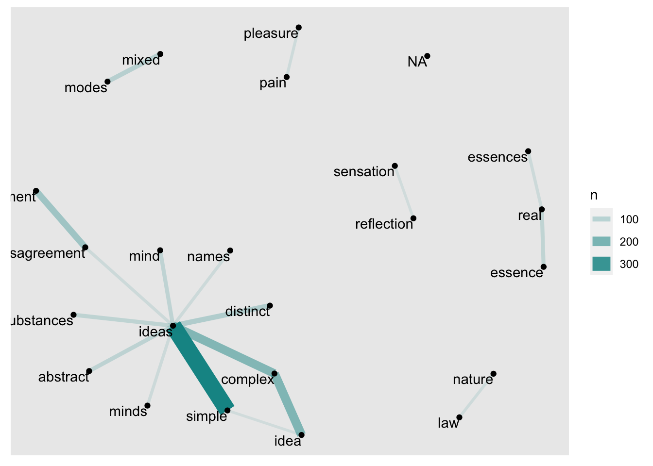
Q3 - is there a relationship among words that appeared more than 50 times?
Locke
Focused primarily on open-ended conceptuals
Words include “simple”, “abstract”, “minds”, “complex” are all related to the main word “ideas”

Slide 8
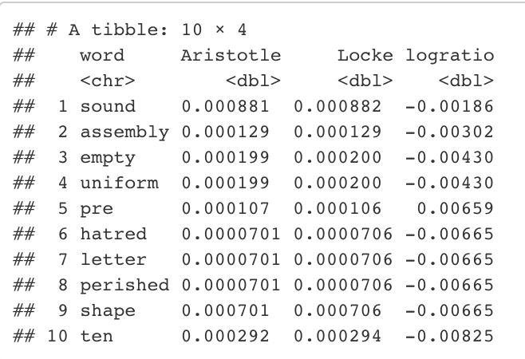
Q4 - are there any words that are equally used by these realists?
Emotional words:
“empty”, “hatred”, “perished”
Having a common purposes:
“uniform” and “assembly”

Slide 9
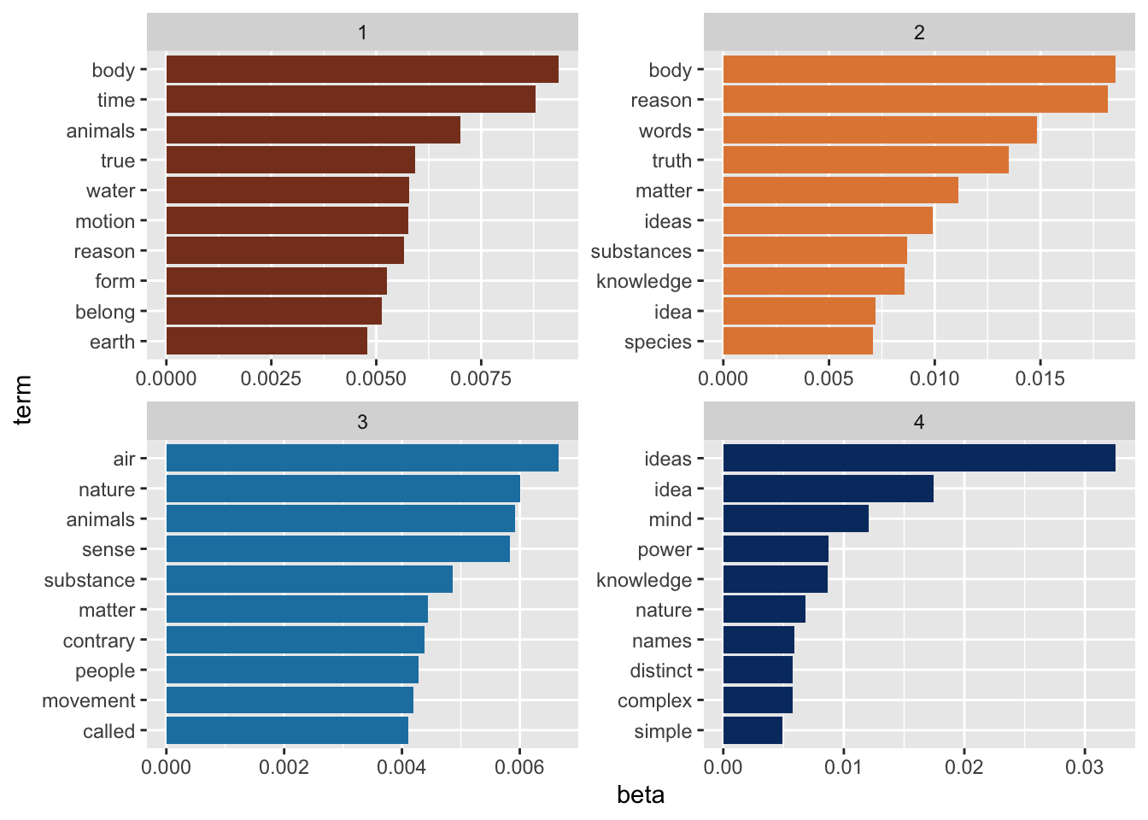

Q5 - what topics do each author’s works fall under?
Aristotle - topic 1 and 3
collection of words related to nature
Locke - topic 2 and 4
collection of words related to human’s logic

Slide 10
So what do we know about the realists’ minds now?
Aristotle is a perceptual realist, of which he believes there is a true reality, and things exist whether humans perceive them or not
Aristotle emphasizes on conceptualizing nature and actual objects to convey his points in his works
Locke is a direct realist, meaning that he believes that humans directly perceive the world
Locke heavily emphasizes on using human’s logical thinking and minds to convey his intended message

